Slide 1


GRADE 8 ICT/DESIGN
Lesson 6: Feedback and Testing (Code.org)
Ms. Abboud • Grade 8 - ICT/Design • Term 1, Week 6

Slide 2
Learning Objectives
WALT - We Are Learning To
WILF - What I'm Looking For
Categorize and prioritize user feedback.
Improve a screen design based on that feedback.
Feedback is sorted into clear, labeled categories.
The improved screen clearly responds to one category of feedback.

Slide 3
Academic Vocabulary
Feedback
Prioritize
Specific, useful comments from someone else about how well something is working.
Deciding what to work on first based on what matters most.

Slide 4
Frayer Model: Feedback
DEFINITION
CHARACTERISTICS
Specific, useful comments from someone else about how well something is working.
Specific; about how something works; from someone else.
FEEDBACK
EXAMPLES
NON-EXAMPLES
"This button is hard to find because it's the same color as the background."
A vague comment like "looks cool."

Slide 5
National Identity Integration
UAE spirit of continuous improvement: government and business services in the UAE are regularly redesigned based on user feedback. Today you use that same process to improve an app.

Slide 6
STARTER
Journal: A Hard-to-Use App
Think of an app that was hard to use.
What exactly didn't you like? How could it be improved?
Hook • Engage & Ask
5 - 10 minutes

Slide 7
LESSON CORE
I Do: From Feedback to Change
Designers turn what users say into changes to the screen.
Today: feedback from users of the Txt Ur Grndkdz app from Lesson 5.
Sort it, choose what matters most, then improve one screen.
Gradual Release of Responsibility
35 - 45 minutes
1 / 3

Slide 8
LESSON CORE
We Do: Sort the Feedback
In groups of 2-3, sort the Prototype Feedback slips into categories of similar problems.
Justify each category: 'We grouped these because...'
Choose the category that matters most: 'This matters most because...'
Gradual Release of Responsibility
35 - 45 minutes
2 / 3

Slide 9
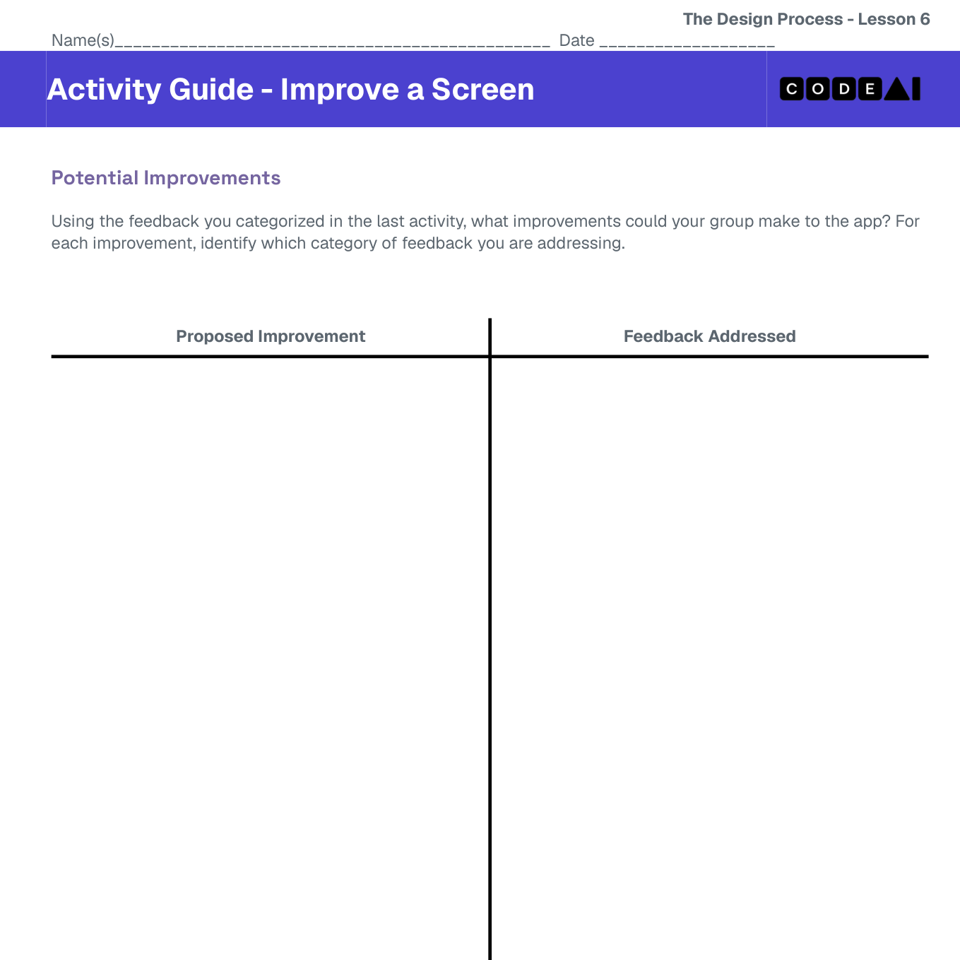
LESSON CORE
You Do: Improve a Screen
Propose improvements linked to your top category.
Redesign one screen on the Improve a Screen activity guide.
Code.org activity: Improve a Screen
Gradual Release of Responsibility
35 - 45 minutes
3 / 3

Slide 10
CLOSURE
Exit Ticket
Which piece of feedback did your group decide NOT to act on, and why?
Transition & Extend
5 - 10 minutes

